Slide 1
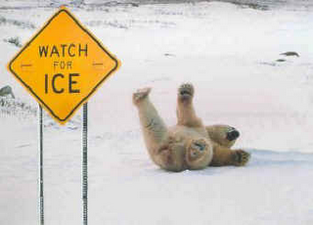
Forces That Oppose Motion
Its not just
science friction

Slide 2
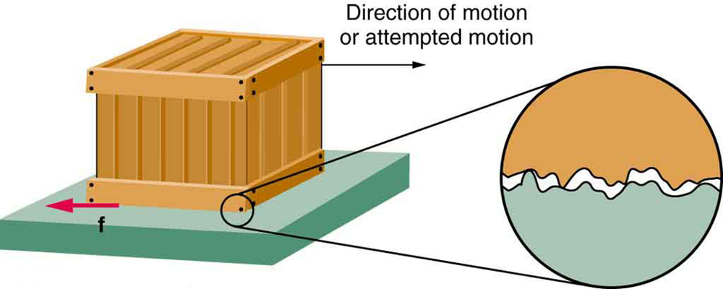
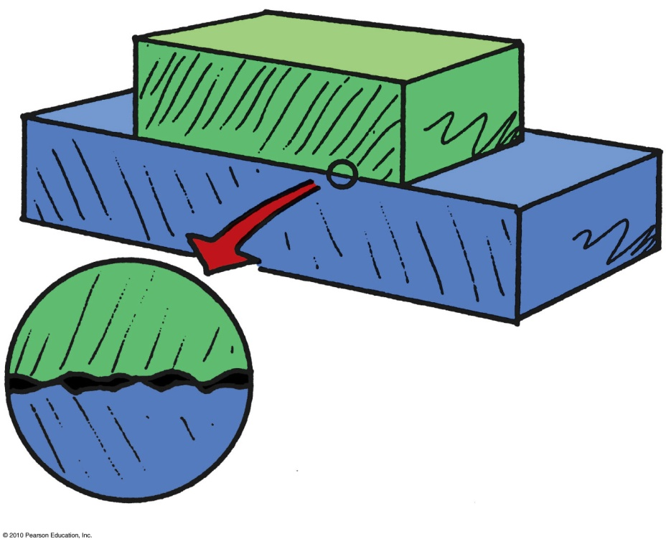
The Force of Friction
Opposes motion – occurs when surfaces slide over each other
Depends on the kinds of material and how much they are pressed together.
Is due to tiny surface bumps and to “stickiness” of the atoms on a material’s surface.
Example: Friction between a crate on a smooth wooden floor is less than that on a rough floor.

Slide 3
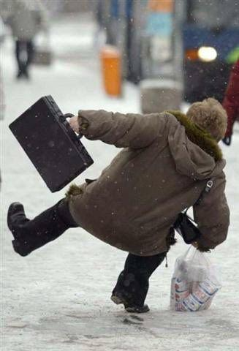
Friction isn’t All BAd
It is essential – without it, the world would be very different
walking, gripping objects running and even standing in place would be impossible

Slide 4
More Friction
Friction does not exist if an object at rest with no external force acting on it
If a force is applied, friction resists the movement
-if the friction resisting motion is equal to the applied force, then no motion occurs
-friction that holds an object in place is called static friction - represented by f_{s}

Slide 5
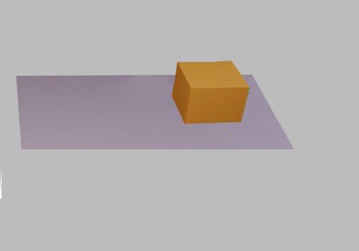
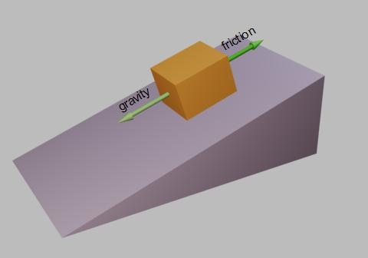
Gravity acts on the box:
static friction holds the
box in place
No force acts on the box
so no friction exists

Slide 6
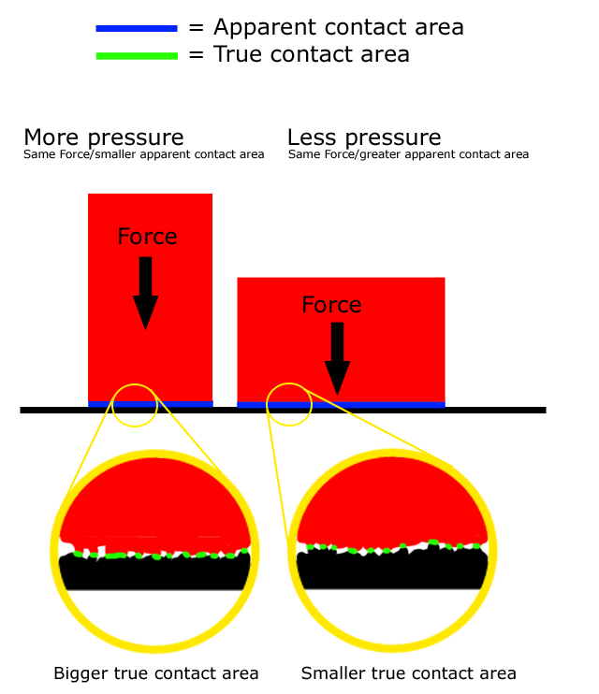
Surface Area and Friction
Friction is independent of an object’s surface area
- it varies with the mass of the object
- the greater an object’s mass, the more force is applied at the point of contact between the objects

Slide 7
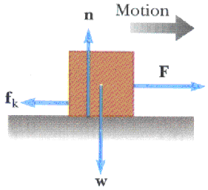
Sliding Friction aka - Kinetic friction
Once the force overcomes static friction, the object begins to move
- the motion is still opposed by friction – sliding friction or kinetic friction
- represented by f_{k}
- Sliding friction resisting an object’s motion is not affected by the speed at which the object moves

Slide 8
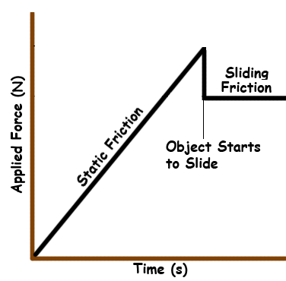
Static vs Kinetic Friction
In general, static friction is greater than kinetic friction
-meaning: it takes more force to start an object moving than it does to keep it moving

Slide 9
Comparing Static and Sliding Friction
Coefficient of Coefficient of
Material Static Friction Sliding Friction
Hard Steel on Hard Steel 0.78 0.42
Glass on Glass 0.94 0.04
Oak on Oak 0.54 0.32
Teflon on Steel 0.04 0.04
Aluminum on Steel 0.61 0.41
Rubber Tire on Concrete (low speed) 0.9 0.7
Rubber Tire on Wet Concrete (low speed) 0.7 0.5
Steel on Ice (skates) 0.02 0.01
Waxed Skis on Wet Snow 0.14 0.10

Slide 10
Force of Friction
The force of friction is equal to the normal force multiplied by the coefficient of friction between two surfaces
f_{s} = F_{N} μ_{s} and f_{k} = F_{N} μ_{k}
F_{N}
w
F_{f}

Slide 11
Finding static friction
f_{s} = F_{N} μ_{s}
Begin by calculating F_{N} F_{N} = weight of the box
An 2kg oak block is at rest on an oak table
What is the maximum amount of static friction between the block and the table
From F = ma - w = mg
w =(2kg)(9.8m/s²)
w = 19.6 N
F_{N} = 19.6N
The coefficient of static friction for oak on oak is μ_{s} = 0.60
f_{s} = (19.6N)(0.54)
2 kg
f_{s} = 10.58 N
F_{N} =19.6 N
w =19.6 N
f_{s} = 10.58 N

Slide 12
Using Kinetic Friction
How much kinetic friction resists the motion of the moving box?
F_{N} = 19.6 N and the coefficient of kinetic friction of oak on oak is 0.32
so
f_{k} = F_{N} μ_{k}
f_{k} = (19.6 N)(0.32)
f_{k} = 6.27N
F_{N} =19.6 N
w =19.6 N
f_{k} = 6.27N

Slide 13
If Fluffy the Wonder Hamster pushes on the box with a force of 11 N, will the box move?
F_{net} = F – f_{s} F_{net} = 11 N – 10.58 N F_{net} = 0.42 N
What is the acceleration experienced by the box?
F_{net} = F - f_{k} F_{net} = 11 N – 6.27 N F_{net} = 4.73 N
F_{net}
m
a =
F_{net} = 4.73 N
m = 2kg
4.73 kg m/s²
2 kg
11 N
F_{N} =19.6 N
a =
w =19.6 N
a = 2.37 m/s²
f_{k} = 6.27N

Slide 14
Calculating the Coefficient of Friction
if the force of static friction is equal to f_{s} = F_{N} μ_{s}
then it would reason that
- What does f_{s} = ?
f_{s} = maximum static friction that exists between 2 surfaces
This makes it equal to the maximum force that can be applied to an object without movement occurring
f_{s}
F_{N}
= μ_{s}
F_{N} =19.6 N
F_{a max}
w =19.6 N
f_{s} = ?

Slide 15
Calculating the coefficient of Static Friction
A 2kg brick rests on a wooden surface.
A maximum force of 11.8 N can be applied to the brick without it beginning to move.
What is the coefficient of static friction for the brick and wood?
Since maximum applied force = maximum static friction
f_{s}
F_{N}
F_{N} =19.6 N
11.8N
19.6N
= μ_{s}
= 0.60
F_{a max} = 11.8N
f_{s} = ?
w =19.6 N

Slide 16
Calculating the coefficient of Kinetic Friction
Since f_{k} = F_{N} μ_{k}
The coefficient of kinetic friction can be found using
How do you find f_{k} ?
f_{k} is equal to the applied force needed to keep the object moving at a constant velocity
f_{k}
F_{N}
= μ_{k}
v = 1m/s
f_{k}
F_{N}
F_{N} =19.6 N
= μ_{k}
8.8N
19.6N
= 0.45
F_{a} = 8.8 N
f_{k} = ?
w =19.6 N

Slide 17
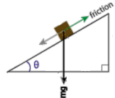
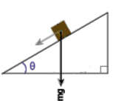
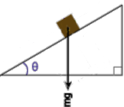
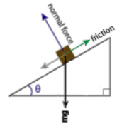
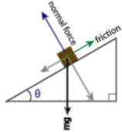
Coefficients of Friction For Advanced Beginners- Force OF FRICTION on an Incline PLANE
An object’s weight acts straight down
On an incline however, a component of the weight acts parallel to the incline – if the object doesn’t move, then the force of static friction is equal in magnitude to this parallel component of weight
The normal force acts perpendicular to the incline
The magnitude of the normal force is equal to the component of the weight that acts perpendicular to the incline

Slide 18
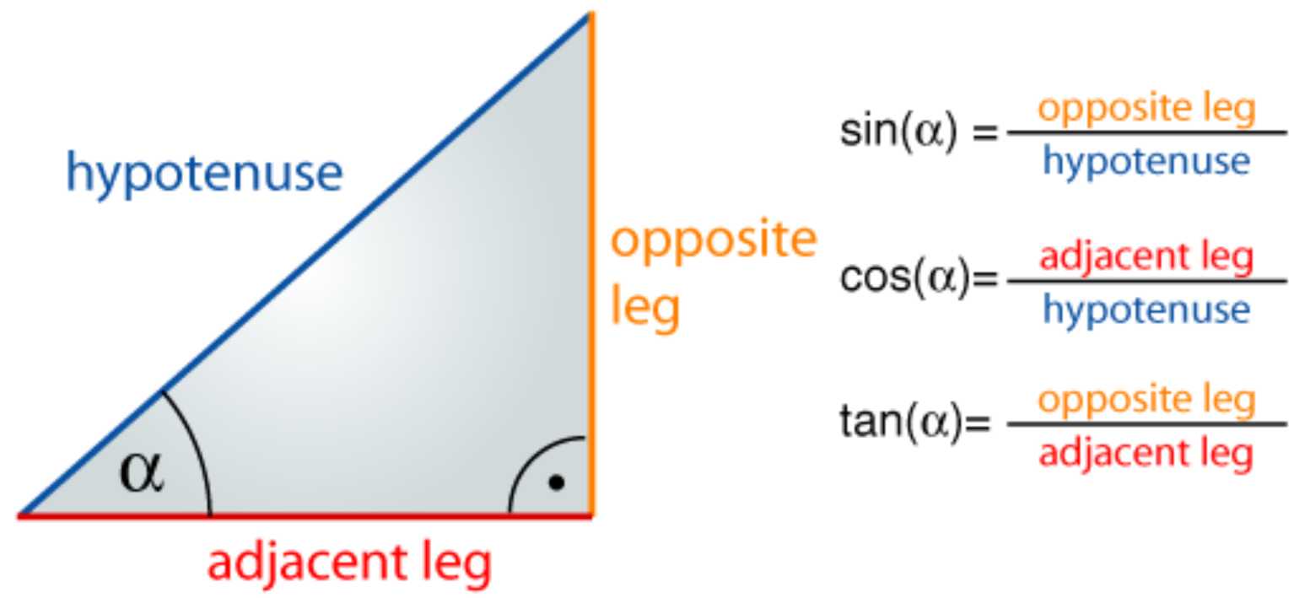
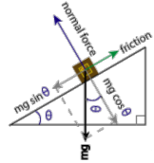
A bit of trigonometry necessary to find for calculating the force of friction on an incline
The component of weight parallel to the
incline is equal to mg(sinθ)
This can be used as F_{friction}
The component of weight perpendicular to the
incline can be found using mg(cosθ)
This can be used as F_{N}

Slide 19
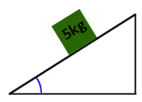
A 5kg wooden box is at rest on a ramp
with a 40º angle
What is the normal force provided by the
ramp?
mg
40º
Normal force = mg (cos40º) = (5kg)(9.8m/s²)(cos40º) =37.5 N
How much static friction is acting on the box?
Since the box isn’t moving the force of static friction is equal to the force parallel to the ramp
f_{s} = mg(sin40º) = (5kg)(9.8m/s)(sin40º) =31.5 N
If the coefficient of friction between the box and the ramp is 0.85 what is the
maximum amount of static friction that can act on the box?
f_{s} = F_{N} μ_{s} becomes
f_{s} = mg(cos40º)(0.85) = (5kg)(9.8m/s²)(cos40º)(0.85) = 31.9N

Slide 20
Fluid Friction
Friction occurs in fluids – liquids and gasses
- air resistance is a form of fluid friction
-air resistance increases with speed
- as your speed increases, you encounter air molecules more often, increasing the resistance they provide

Slide 21
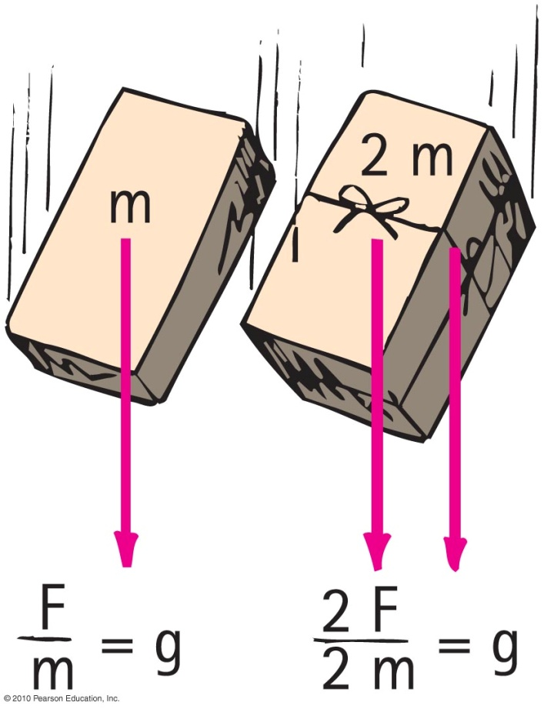
Non-Free Fall
When an object falls downward through the air it experiences
force of gravity pulling it downward.
air drag force acting upward.
2nd Law
in Free Fall
2nd Law
in Non-Free Fall
2nd Law

Slide 22
Non-Free Fall
When acceleration of fall is less than g, non-free fall
occurs when air resistance is a factor
depends on two things:
speed – the faster an object falls, the more air
molecules it encounters
- as an object falls faster the molecules it encounters have more impact
- so …greater speed = greater air resistance
frontal surface area – the more frontal surface area on an object, the more air molecules it will encounter

Slide 23
Non-Free Fall-Terminal Velocity
When the object is moving fast enough that force of gravity equals its air resistance
The object is in equilibrium
so
There is no net force
No acceleration
Velocity does not change

Slide 24
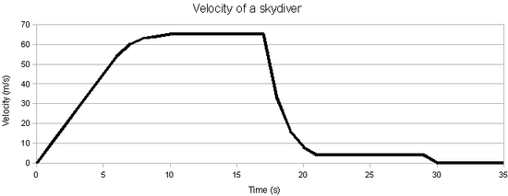
Non-Free Fall—Example
A skydiver jumps from plane.
Weight is the only force until air resistance acts.
As falling speed increases, air
resistance on diver builds up,
net force is reduced, and
acceleration becomes less.
When air resistance equals the diver’s weight, net force is zero and acceleration terminates.
Diver reaches terminal velocity, then continues the fall at constant speed.

Slide 25
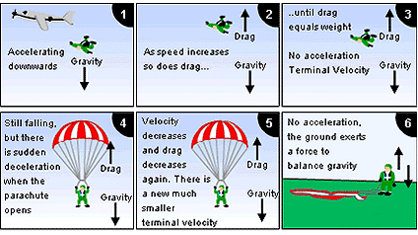
Non Free Fall
2.
3.
4.
1.
5.
6.

Slide 26
When a 20-N falling object encounters 5 N of air resistance, its acceleration of fall is
Non-Free Fall
CHECK YOUR NEIGHBOR
A. less than g.
more than g.
C. g.
terminated.
Notes:
A. less than g.

Slide 27
If a 50-N person is to fall at terminal speed, the air resistance needed is
Non-Free Fall
CHECK YOUR NEIGHBOR
A. less than 50 N.
50 N.
more than 50 N.
None of the above.
Notes:
B. 50 N.

Slide 28
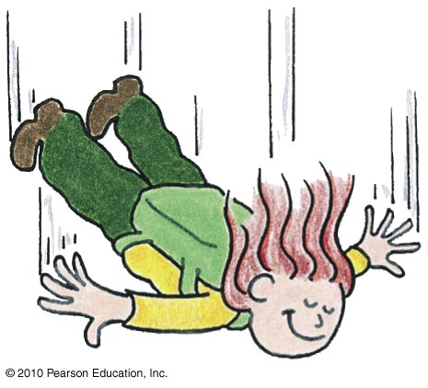
As the skydiver falls faster and faster through the air, air resistance
Non-Free Fall
CHECK YOUR NEIGHBOR
A. increases.
decreases.
remains the same.
Not enough information.
Notes:
A. increases.

Slide 29
As the skydiver continues to fall faster and faster through the air, net force
Non-Free Fall
CHECK YOUR NEIGHBOR
A. increases.
decreases.
remains the same.
Not enough information.
Notes:
B. decreases.

Slide 30
As the skydiver continues to fall faster and faster through the air, her acceleration
Non-Free Fall
CHECK YOUR NEIGHBOR
A. increases.
decreases.
remains the same.
Not enough information.
Notes:
B. decreases.

Slide 31
Consider a heavy and light person jumping together with same-size parachutes from the same altitude. Who will reach the ground first?
Non-Free Fall
CHECK YOUR NEIGHBOR
A. The light person.
The heavy person.
Both will reach at the same time.
Not enough information.
Notes:
B. The heavy person.

Slide 32
Consider a heavy and light person jumping together with same-size parachutes from the same altitude. Who will reach the ground first?
Non-Free Fall
CHECK YOUR ANSWER
A. The light person
The heavy person
Both will reach at the same time.
Not enough information.
Explanation:
They both have the same drag force (for the same speed).
The man (heavier) has a greater downward force than the woman (lighter).
The man has to drop farther to receive drag force equal to his downward force, so a higher terminal velocity.
Notes:
B. The heavy person.

Slide 33
Free Fall vs. Non-Free Fall
Coin and feather fall with air present
Feather reaches terminal velocity very quickly and falls slowly at constant speed, reaching the bottom after the coin does.
Coin falls very quickly and air resistance doesn’t build up to its weight over short-falling distances, which is why the coin hits the bottom much sooner than the falling feather.

Slide 34
When the air is removed by a vacuum pump and the coin and feather activity is repeated,
Non-Free Fall
CHECK YOUR NEIGHBOR
A. the feather hits the bottom first, before the coin hits.
the coin hits the bottom first, before the feather hits.
both the coin and feather drop together side-by-side.
Not enough information.
Notes:
C. both the coin and feather drop together side-by-side.

Slide 35
When the air is removed by a vacuum pump and the coin and feather activity is repeated,
Non-Free Fall
CHECK YOUR ANSWER
A. the feather hits the bottom first, before the coin hits.
the coin hits the bottom first, before the feather hits.
both the coin and feather drop together side-by-side.
Not enough information.
Notes:
C. both the coin and feather drop together side-by-side.

Slide 36
Free Fall vs. Non-Free Fall
Coin and feather fall in vacuum
There is no air, because it is vacuum.
So, no air resistance.
Coin and feather fall together.

